Slide 1

Project Registration and Maintenance
SATHYABAMA INSTITUTE OF SCIENCE AND TECHNOLOGY
Guide Name:
Dr. ALBERT J MAYAN M.E., Ph.D.,
TEAM MEMBERS:
HARIHARAN B P
JAGADEESH N
MOHNISH DEVARAJ

Slide 2
Next Implementations
Host in a improved platform
Implement cloud storage
Increase security
Improve the UI
Implement system for PT-1 & PT-2.
Reduce bugs and concurrency.
Improve Media Query and system mobility.
Collection of reports and implement separate profiles.
Implement the review system and provide remarks .
Certificate collection for pre-final year.

Slide 3
Cloud Storage
To store all the records of the students (includes Research Paper, PPTs, docs) a cloud storage is needed to store these datas for a period of time.
We are planning to use AWS S3 bucket or Google cloud storage depending the cost effectiveness of the cloud.
Amazon S3 provides around 50 GB of storage for the cost of Rs:500 + tax (per month)
Google Cloud Services(GCS) provides around 220 GB of storage for the cost of Rs 210 + tax (per month)

Slide 4
Modules to be used:
Boto3: It’s a python library which can be downloaded using preferred installer program (pip). This creates an API service with local django application to AWS server for performing PUT, GET, POST requests.
django-storages: An open-source library to manage storage backends like Dropbox, OneDrive and Amazon S3. It’s very convenient, as it plugs in the built-in Django storage backend API.
Gunicorn:- Determines what type of Web Application it is i.e. identifies it as WSGI(Web Server Gateway Interface) or ASGI (Asynchronous Server Gateway Interface) and acts as a medium to serve requests from Heroku cloud server to web application in the backend.

Slide 5
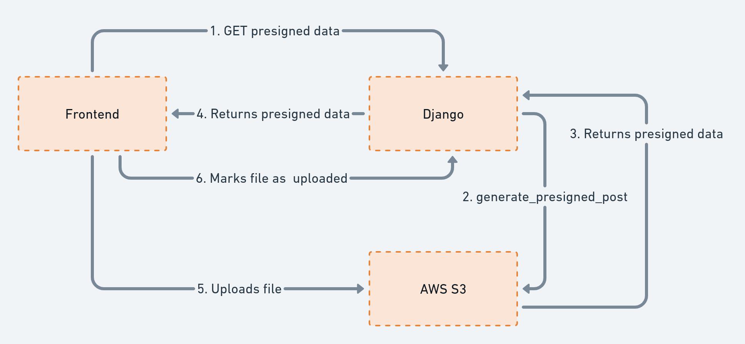
Cloud Work Flow

Slide 6
Problems In Existing System
Data Duplication
Repeated Login
Un authorized changes
Complicated UI
Security Issues
Scalability issues
Cross platform issues
Manual work
Non -Transparent process
Server crowd and Accessing speed

Slide 7
Request Budget from Management
Total Cost Spent Till Now:
1.Go daddy domain: Rs:900 for 2 years
2.Heroku: Rs:00 (was free )
3.SSL key: Rs:00 (was free)
Cost required in future:
1.Railway Hosting: Rs:2100 + tax per month
2.cloud storage: (AWS :S3 standard :Rs:500 + tax per month) (preferred)
(Google cloud: 200GB : Rs : 210 per month)
3.Domain renewal: Rs:1200 per year
4.SSL certificate: (basic: Rs :349 per month)
(Intermediate: Rs : 749 per month) (preferred)
Overall Budget Required :
-The overall cost required for system maintenance per year is approximately Rs:30000 (per year).

Slide 8
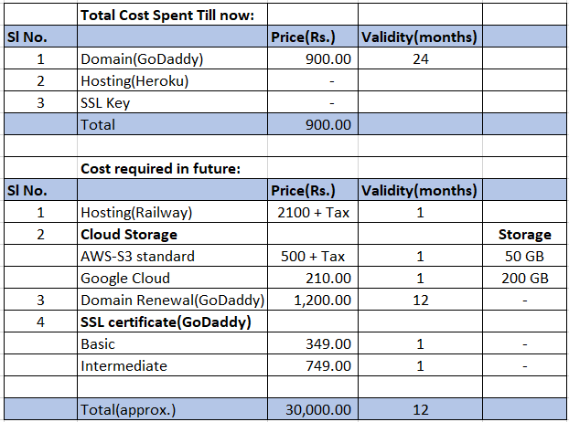
Request Budget from Management

Slide 9
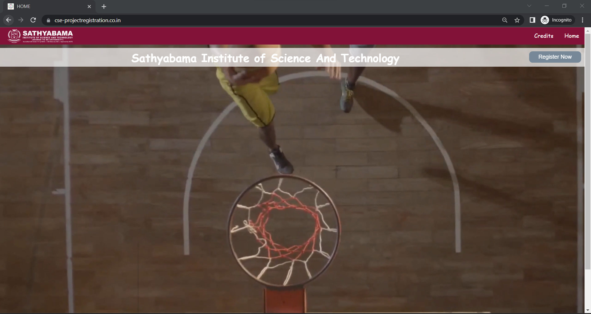
APPLICATION SCREEN SHOT:

Slide 10
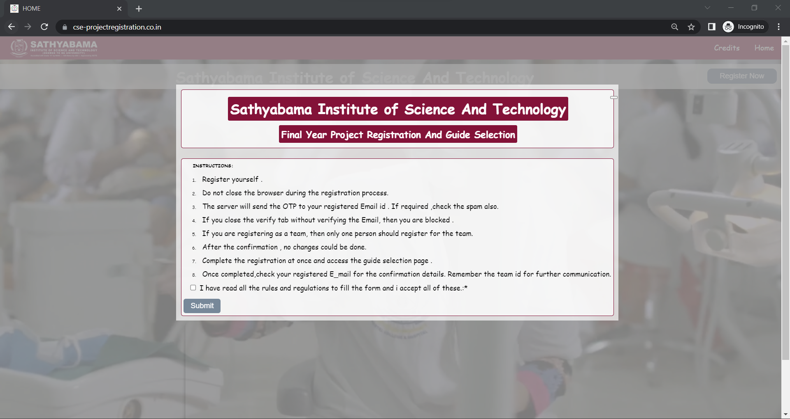

Slide 11
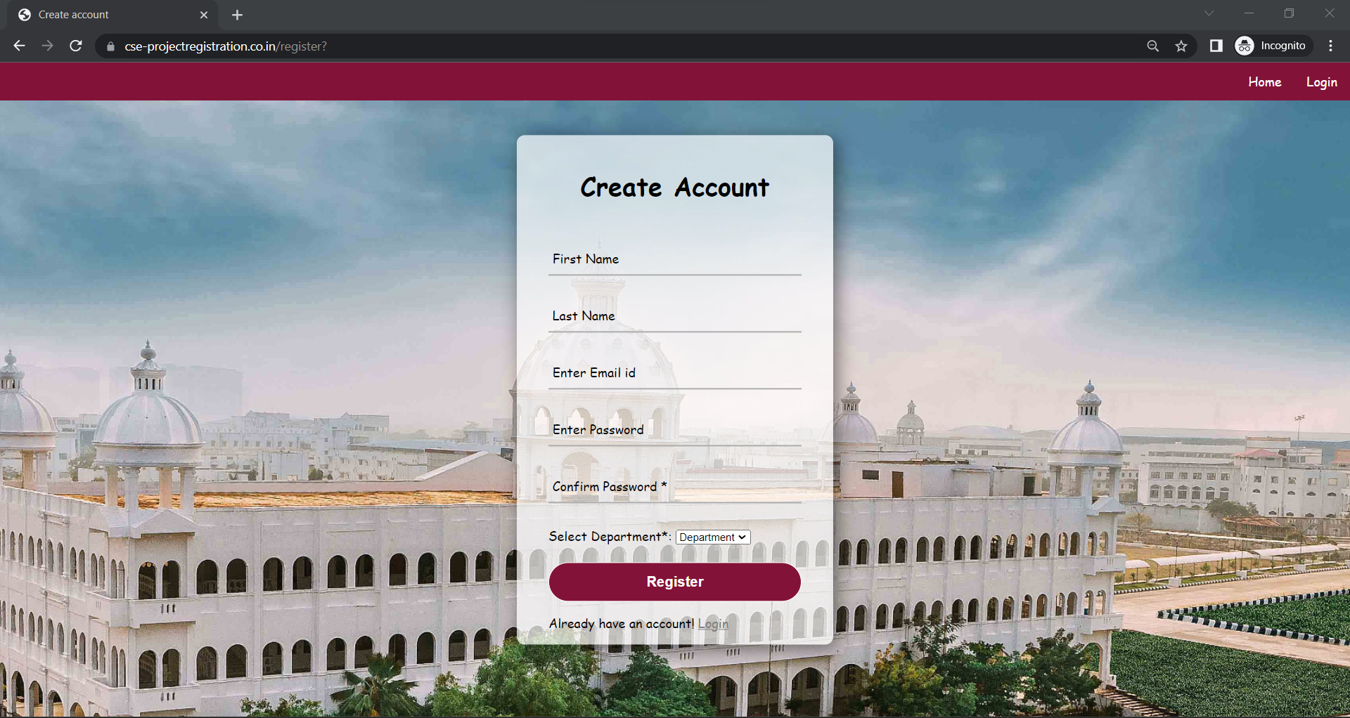

Slide 12
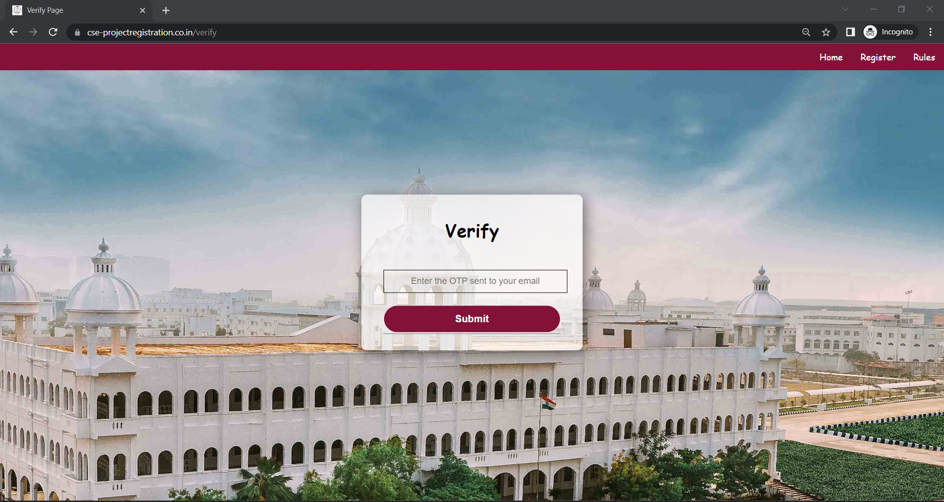

Slide 13
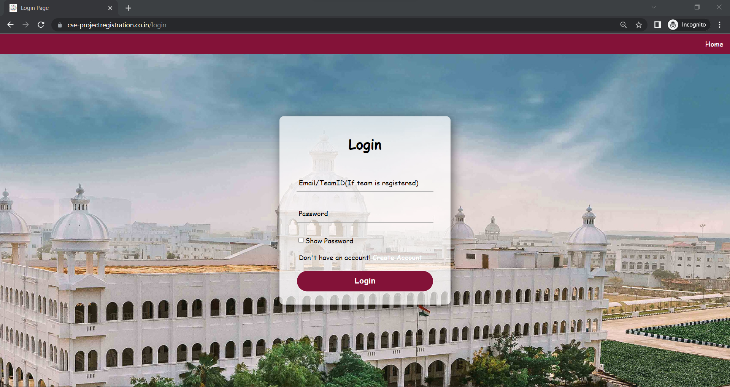

Slide 14
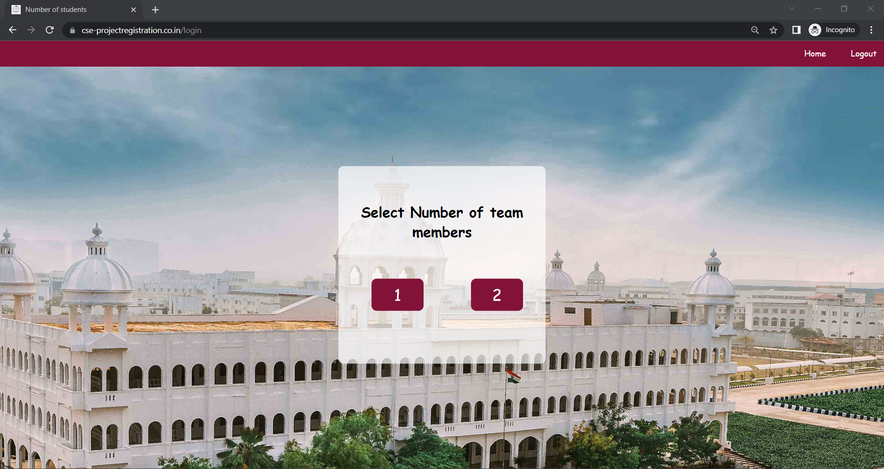

Slide 15
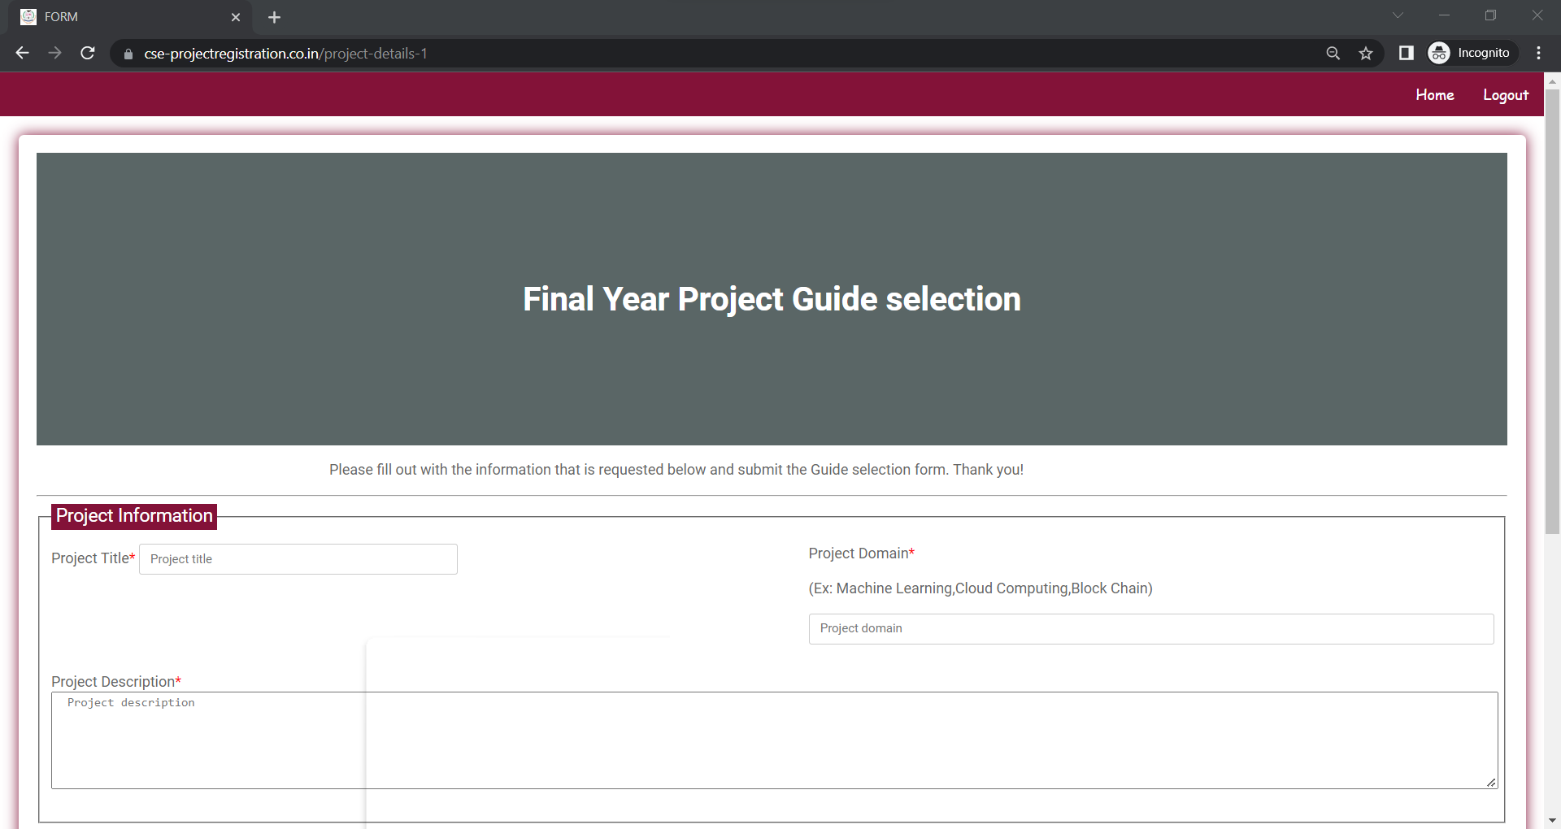
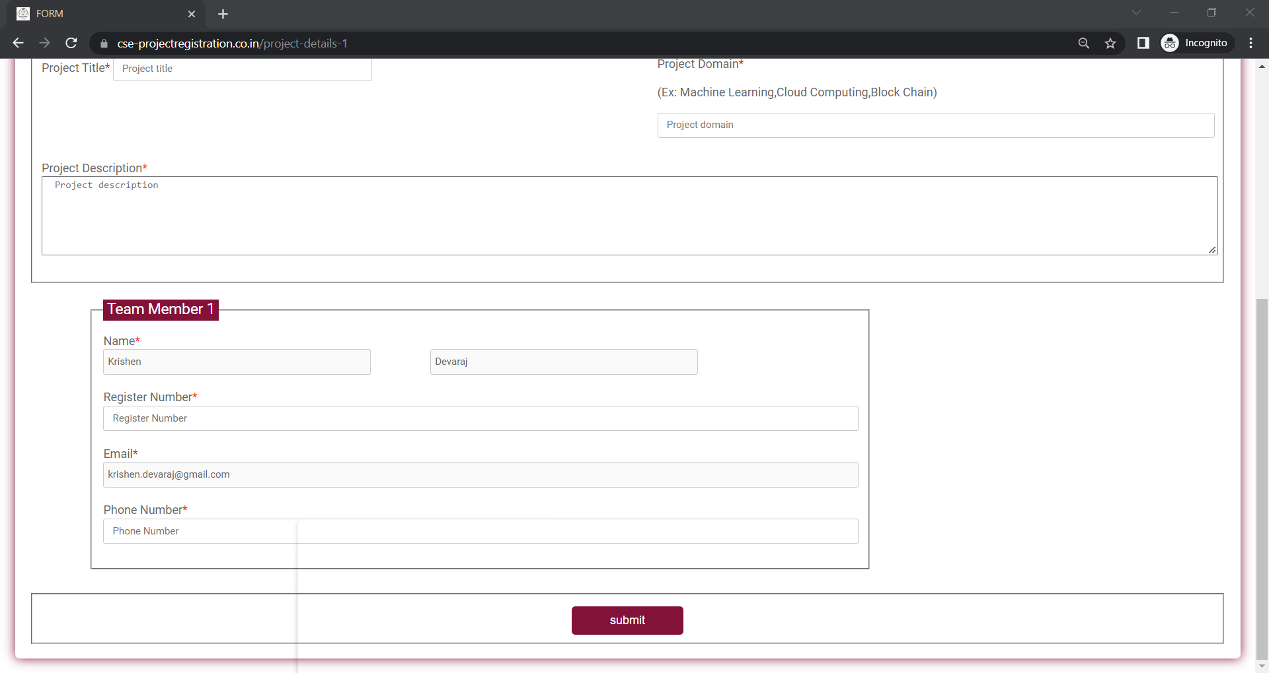

Slide 16
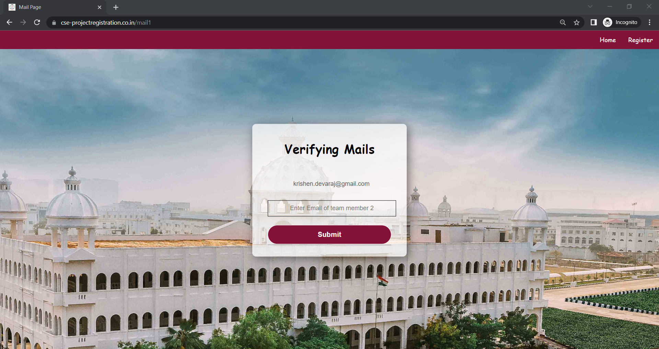
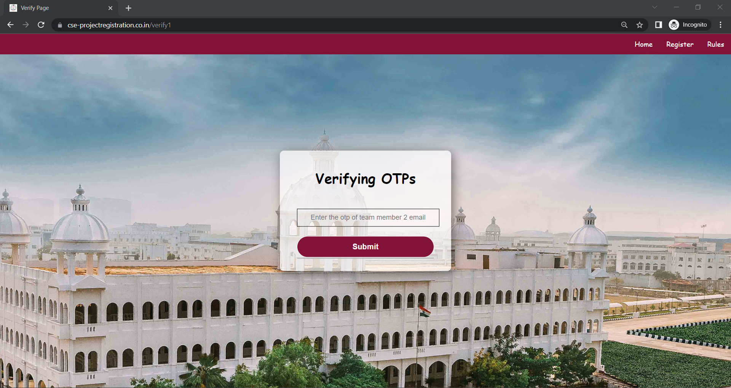
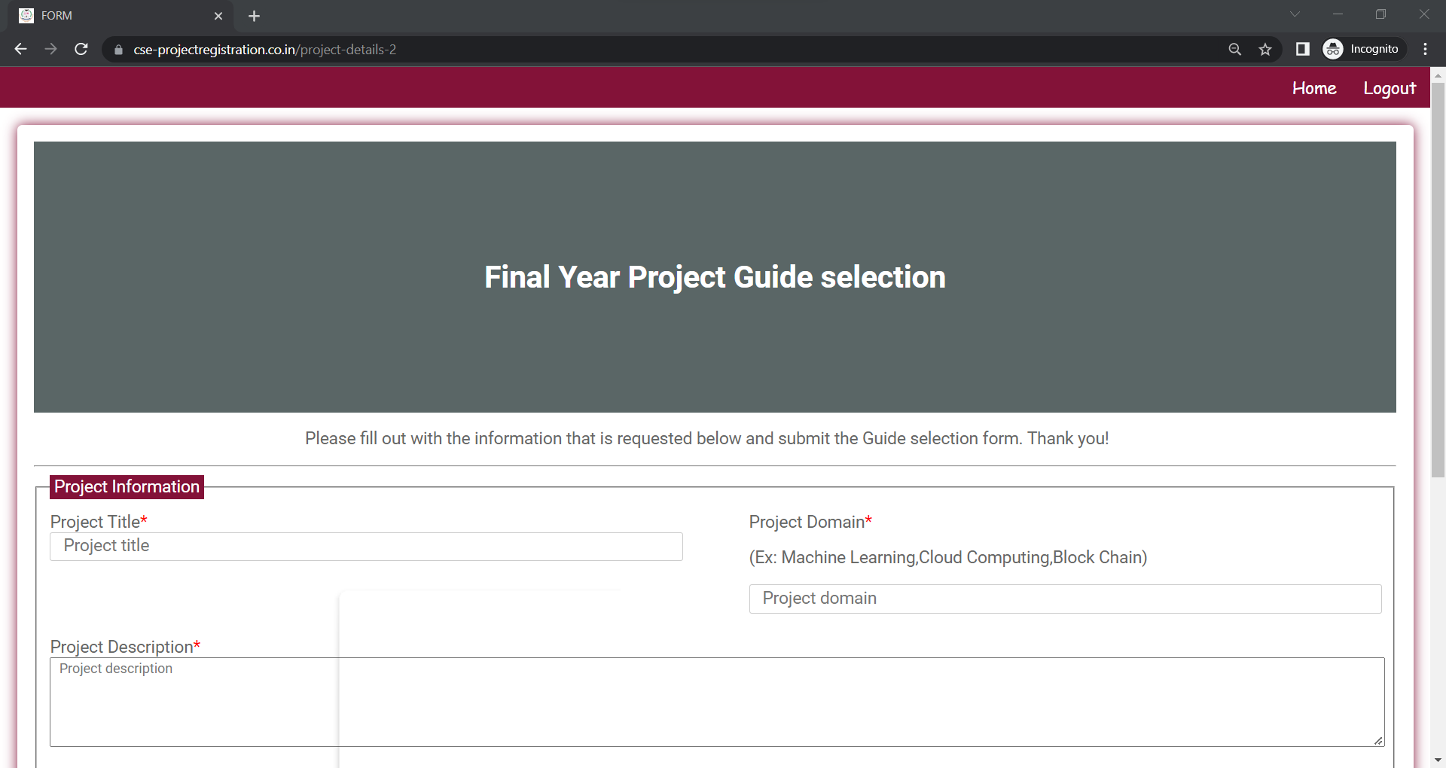
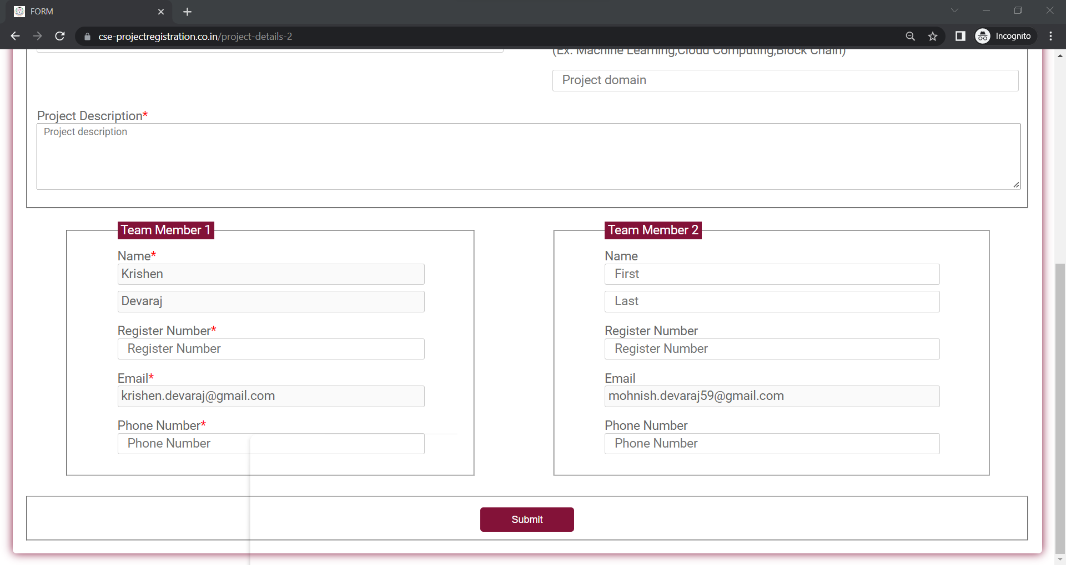

Slide 17
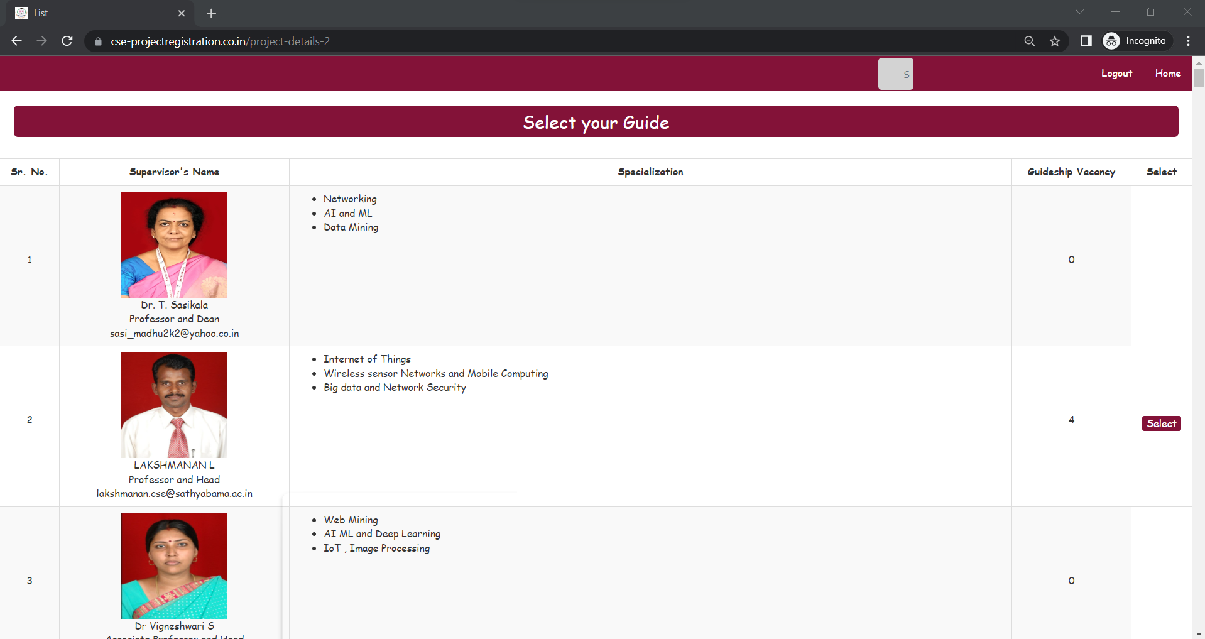

Slide 18
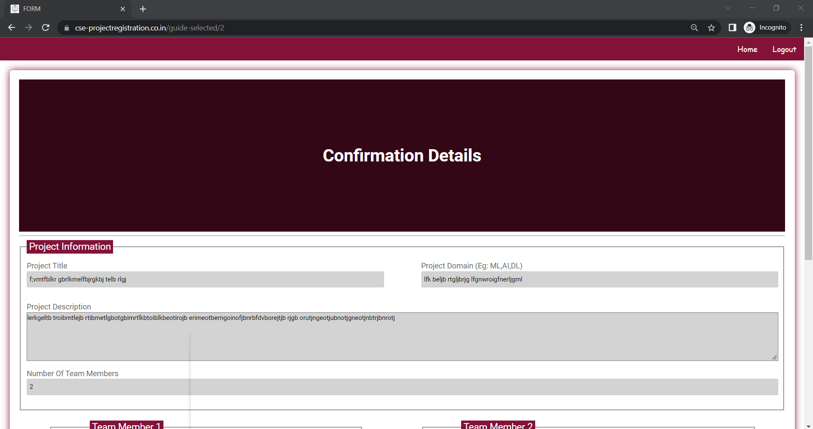
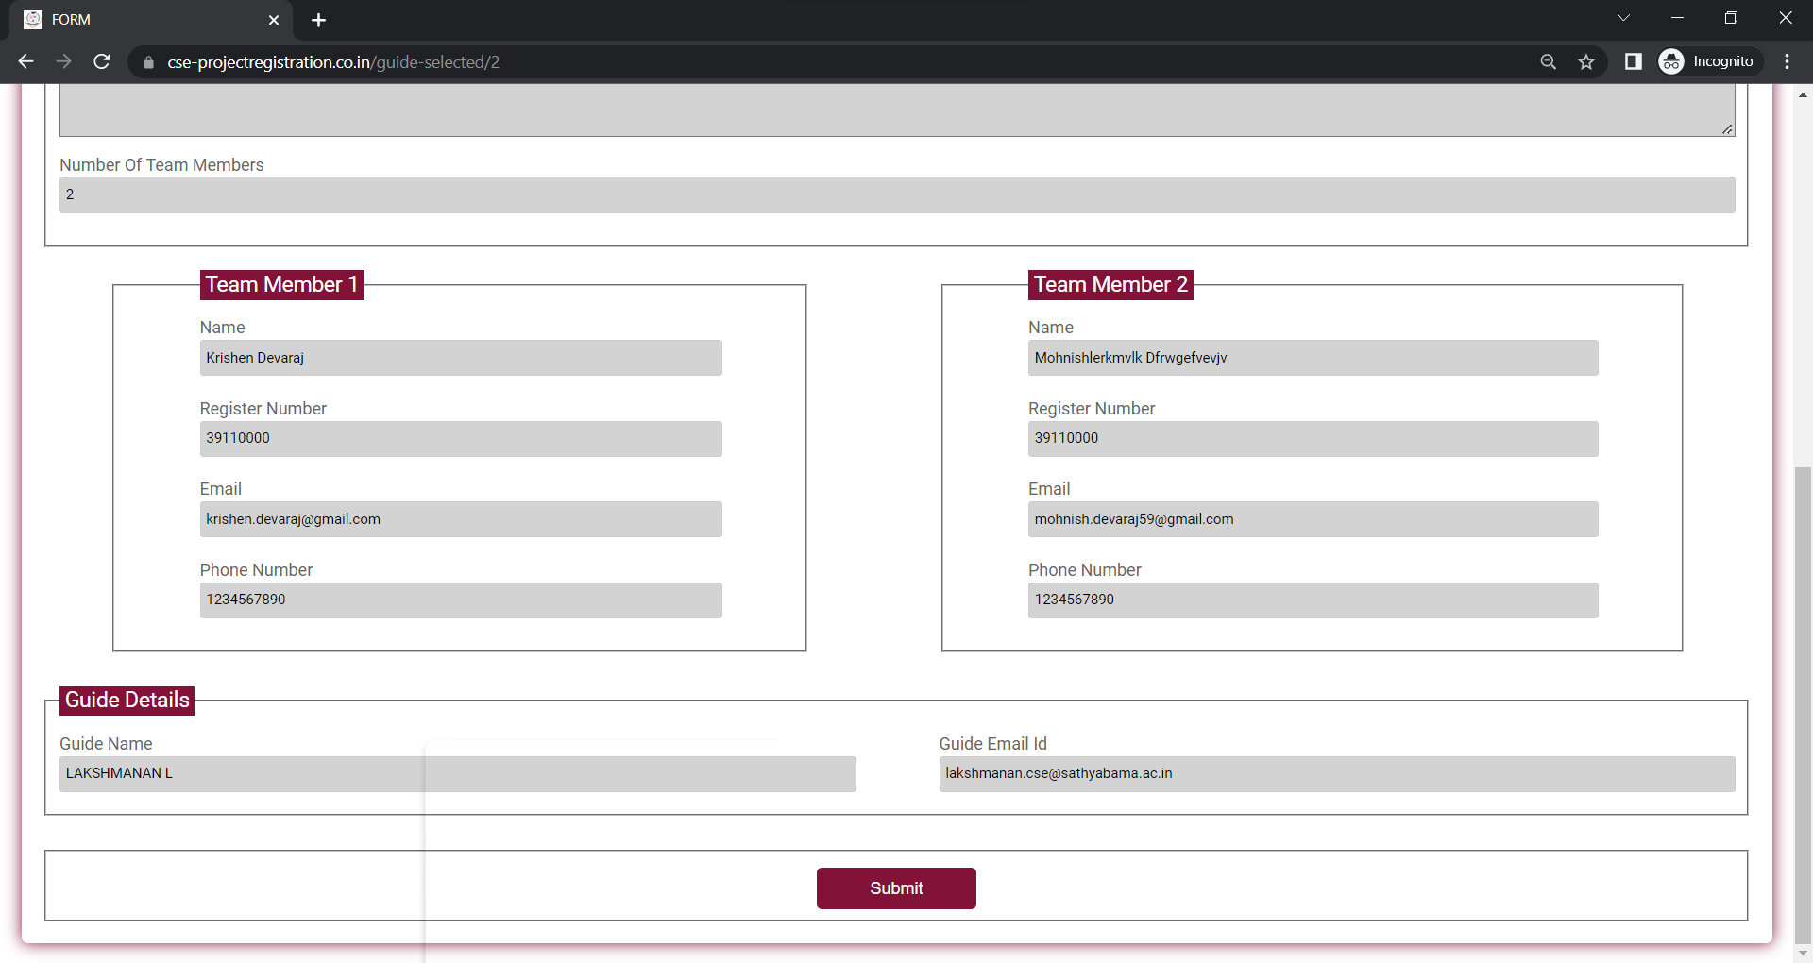

Slide 19
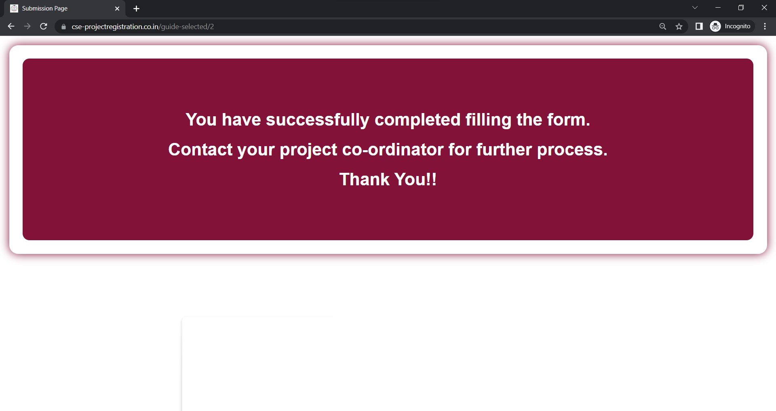

Slide 20
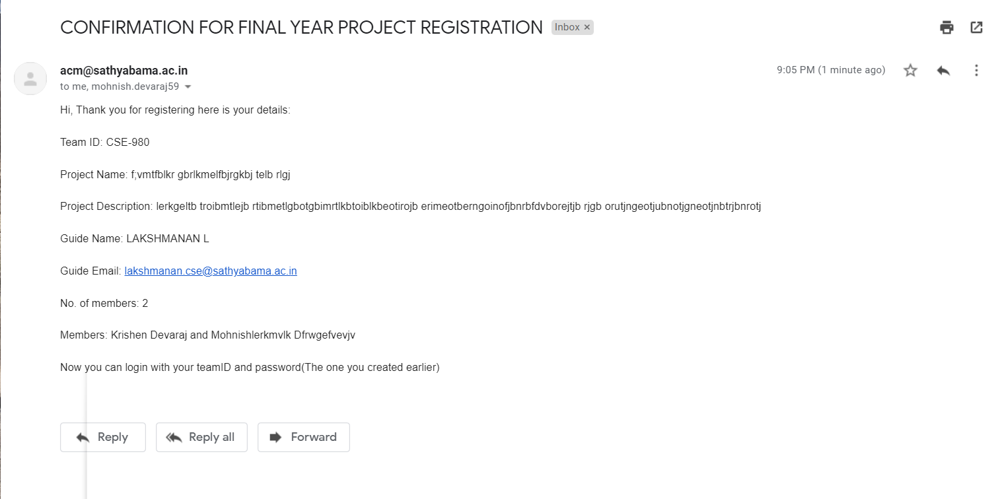

Slide 21


